Slide 1
Name -Mahbub Hasan Prantik
ID - 1612751042
Group - 5
Email - hasan.prantik@northsouth.edu

Slide 2
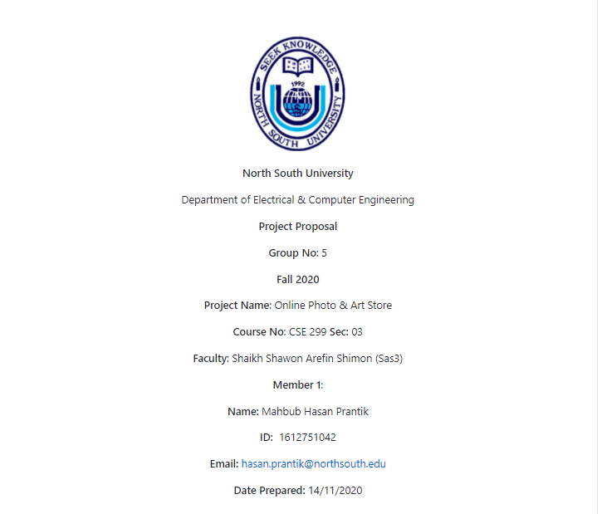
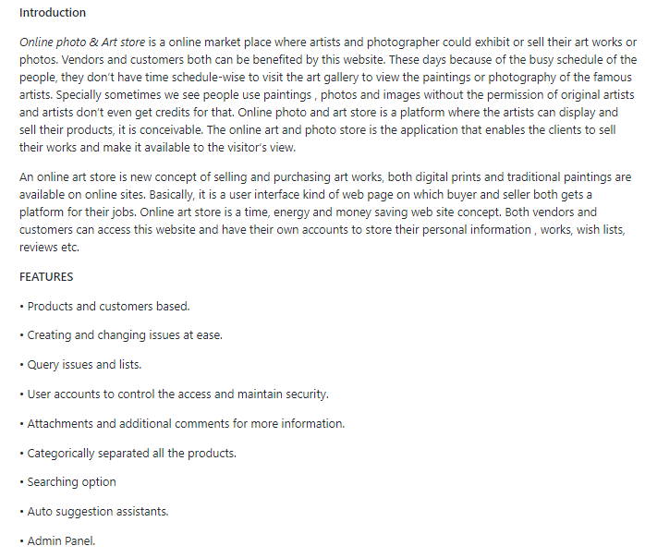
Project Readme

Slide 3
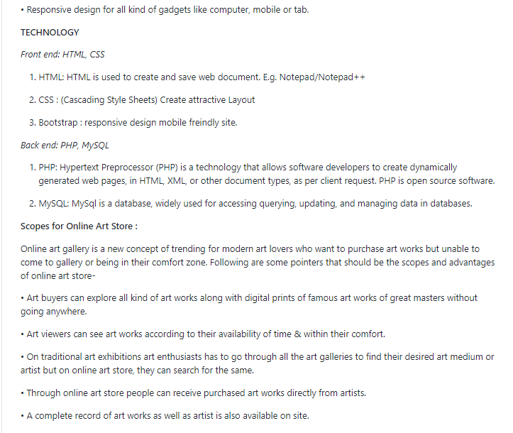
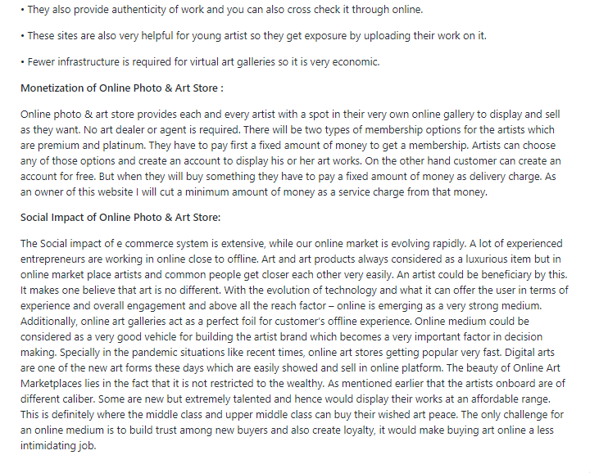
Project Readme

Slide 4
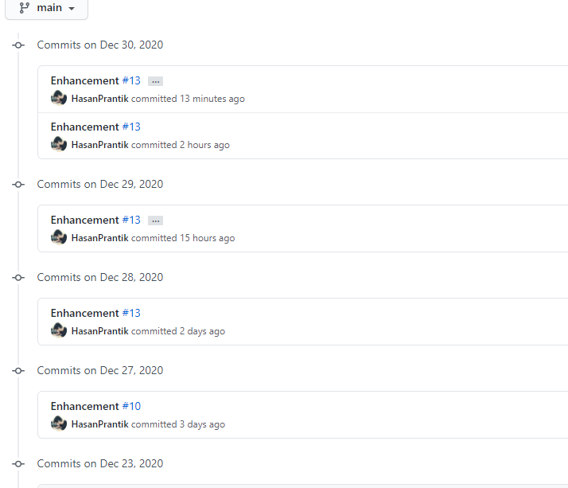
Commits in Week 09

Slide 5
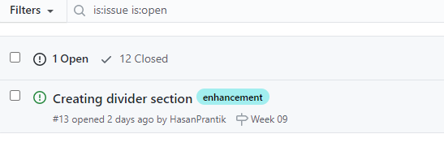
Issues In Week 09

